Slide 1
Jobs in 2050: Novigoting the Future Workforce
A strategic foresight into the macro drivers, emerging industries, and essential skills defining the next era of human capital.

Slide 2
Mocro Drivers of Chonge
Understanding the converging global forces that will permanently reshape industry landscapes and employment paradigms by mid-century.

Slide 3
Forces Shaping the 2050 Landscape
Artificial Intelligence Convergence
AI will transition from isolated tools to pervasive, autonomous systems managing infrastructure, data logic, and operational frameworks.
The human workforce will pivot towards algorithm auditing, ethical oversight, and tasks demanding high emotional intelligence that machines cannot replicate.
The Climate Imperative
Global warming mitigation will not just be an initiative; it will be the foundational economic driver of the 21st century.
Massive capital reallocation will spawn entirely new sectors dedicated to geoengineering, sustainable agriculture, and advanced circular economies.

Slide 4
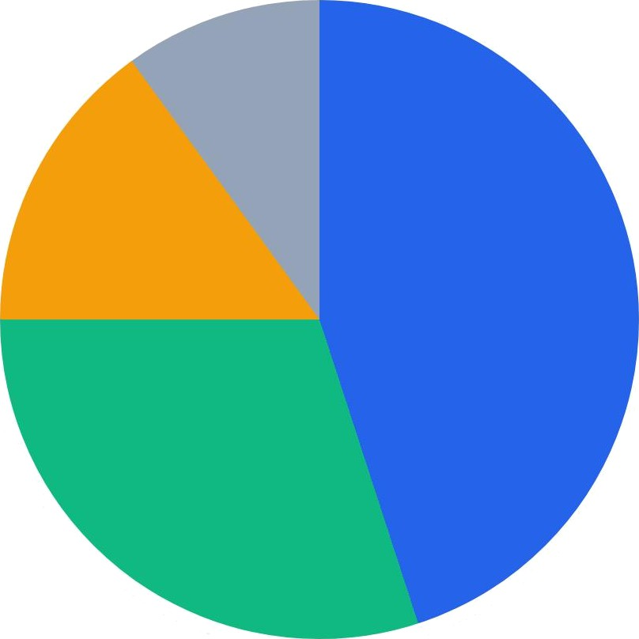
The Workforce Evolution (2025 - 2050)
Transformed Roles (45%)
Entirely New Roles (30%)
@ Displaced/Automated (15%)
Unchanged Roles (10%)
By 2050, an estimated 75 % of the workforce will be engaged in jobs that are either fundamentally transformed by technology or do not yet exist today.

Slide 5
Emerging Industries & Roles
A deep dive into the high-growth sectors poised to dominate the global economy and the specialized talent they will demand.

Slide 6
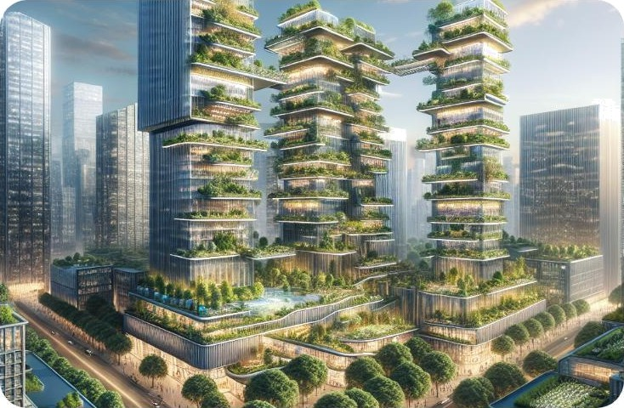
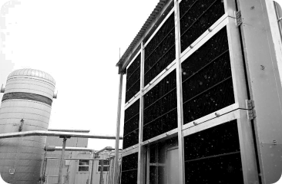
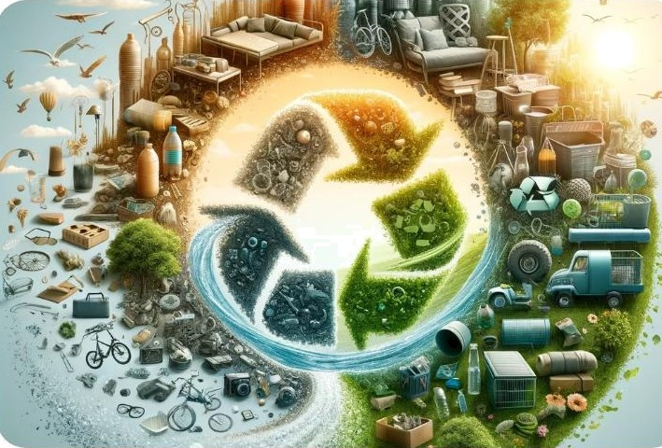
The Trillion-Dollar Green Economy
Urban Agriculturists
Specialists managing vertical farming, integrating food production directly into smart city ecosystems to ensure localized food security.
Climate Engineers
Scientists and technicians operating massive atmospheric carbon capture grids and managing localized weather modification systems.
Circular Material Designers
Engineers focused on zero -waste product lifecycles, developing advanced bio-materials that infinitely recycle without degradation.

Slide 7
onou
a an a a e u a o o
a o a g
Human-Machine Synergy
The Robot Liaison
As autonomous systems become standard in offices and manufacturing lines, a new managerial class will emerge. Robot Liaisons will optimize workflows between biological and synthetic workers.
They will act as mediators, ensuring AI logic aligns with human corporate culture, handling ethical discrepancies, and optimizing collaborative output without compromising safety.

Slide 8

Hyper-Personalized Healthcare
Nonomedicol Architects
The paradigm of medicine will shift from reactive treatment to proactive genetic optimization and cellular repair. Nanomedical Architects will design custom, microscopic robot swarms injected into patients to target specific diseases, repair aging cells, and enhance physical resilience. This role bridges advanced biology with micro-robotics, fundamentally altering human longevity.

Slide 9
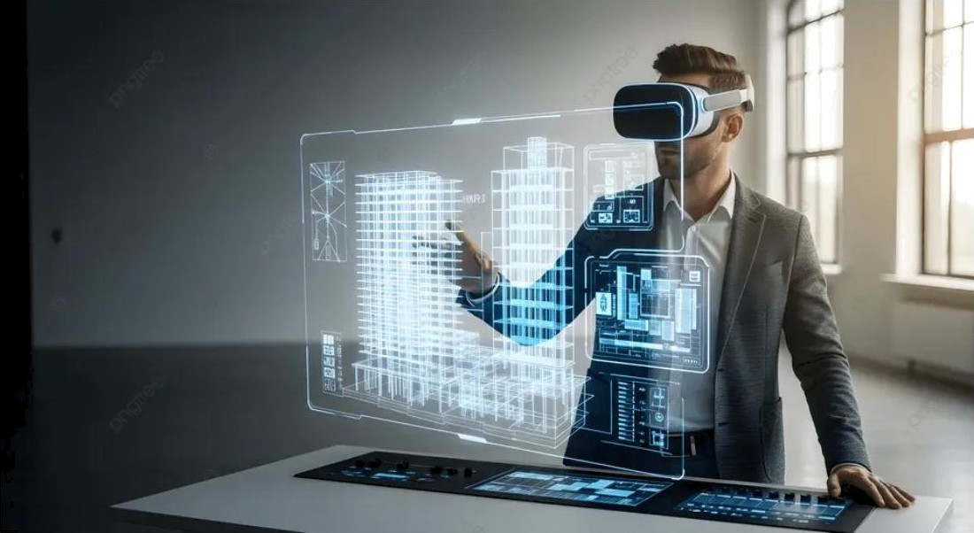
The Immersive Web & Metoverse
The 2D internet will be entirely replaced by 3D, immersive spatial computing environments used for both commerce and leisure.
Virtual Environment Architects: Digital urban planners who design the physics, aesthetics, and economic logic of massive metaverse platforms.
Digital Identity Defenders: As life moves online, security experts dedicated to protecting highly valuable digital avatars and virtual assets from quantum hacking.
Haptic Interface Designers: Engineers creating sensory suits and neural links to make digital interactions feel physically real.

Slide 10
The NewEro of Skills
As hard skills become rapidly obsolete, the premium will shift entirely toward enduring cognitive and emotional capabilities.

Slide 11


Skill Demand Trajectory (Current vs 2050)
Complex Problem
Solving
r
a
Emotional Intelligence
a
70% Growth
Tech/AI Management
Manual / Routine Tasks
The market will ruthlessly penalize highly routine, predictable work while intensely rewarding the ability to navigate ambiguity, empathize, and manage complex systems.

Slide 12
Essential Competencies for 2050
Hyper-Adaptability (Agility Quotient)
The ability to rapidly unlearn outdated paradigms and acquire new skills every 2-3 years. Static degrees will be replaced by continuous micro-credentialing.
,”•’ "•*
Advanced Emotional Intelligence (EQ)
As machines handle logic, humans must handle relationships. Deep empathy, cross-cultural negotiation, and complex team building will be the ultimate premium skills.
Systems Thinking
The capacity to understand how various complex components (AI, ecology, economics) interact holistically, foreseeing second and third-order consequences.
@ Digital Ethics & Philosophy
Determining the moral boundaries of technological implementation. Leaders must answer "should we?" rather than just "can we?" regarding AI and biotech.

Slide 13
Transformation Milestones
2050
Biological enpineerinp and seamless Human-AI neural interfacing become standard professional requirements in top tiers.
2035
Climate tech boom. The majority of new capital is deployed into carbon capture, alternative proteins, and preen prids.
2030
Widespread adoption of AI co- pilots in white-collar roles. Routine coding and legal discovery fully automated.
2045
Mainstream Spatial Computinp.
Physical offices are largely
obsolete, replaced by hyper- realistic plobal digital hubs.

Slide 14
The greotest donger in times of turbulence is not the turbulence; it is to oct with yesterdoy's logic.
— Peter Drucker

Slide 15
Questions?
Thank you for your attention on navigating the future of work.
strategy@futureworkforce.com | www.futureworkforce2050.org

Slide 16
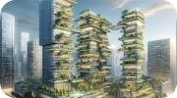

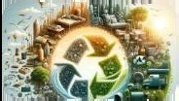




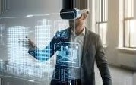
Image Sources
https://mainifesto.com/wp-content/uploads/2025/05/Vertical-Farming-Sustainable-Agriculture-Solutions-for-Urban-Spaces-1.png
Source: mainifesto.com
https://grist.org/wp-content/uploads/2023/09/CarbonCapture.jpg?quaIity=75&strip=all Source: grist.org
https://blog.gdeItproject.org/wp-content/uploads/2023-12-genai-circuIar25.png Source: blog.gdeItproject.org
https:lli.ytimg.com/vi/j4dc9oTr5G0/hq720.jpg?sqp=-oaymwEhCK4FEIIDSFryq4qpAxMIARUAAAAAGAEIAADIQj0AgKJD&rs=AOn4CLAxcRjPS7JzYvOWzOEs5M5pxXn03g
Source: www.youtube.com
https://assets.st-note.com/img/177453799J-1AILmZz329DSEadyMrpkhcGX.png
Source: note.com
https://png.pngtree.com/thumb_back/fw800/background/20251127/pngtree-architect-using-vr-headset-to-interact-with-a-hoIographic-building-model-image_2062902 8.webp
Source: pngtree.com

